Slide 1
Module 4
QA

Slide 2

Multiple Linear Regression (MLR)
A dependent variable (y) is related to more than one independent variable.
This relationship can be estimated, it may enable us to make more precise predictions of the dependent variable than would be possible by a simple linear regression.
Regressions based on more than one independent variable are called multiple regressions.
Scatterplots, correlation, and least squares method are still essential components for a multiple regression.
The general linear regression model takes the form of
y is the random response variable
β0, β1, β2, and βk are the parameters to be estimated based on the sample data
x1, x2,…, xk are the predictor variables that are assumed to be non-random or fixed and measured without error, and k is the number of predictor variable,
and ε is the random error, which allows each response to deviate from the average value of y

Slide 3
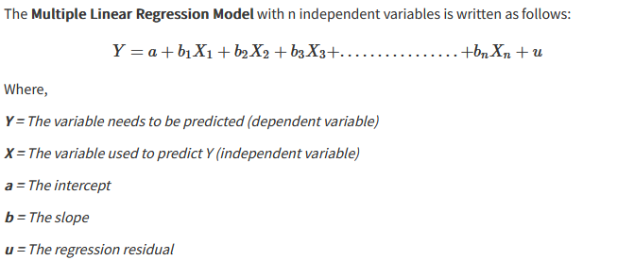
Basic Condition for Multiple Regression
There must be a linear relationship between the independent variable and the outcome variables.
It considers the residuals to be normally distributed.
It assumes that the independent variables are not highly correlated with each other.

Slide 4
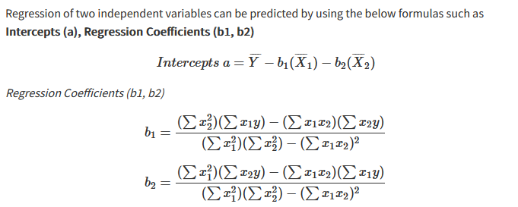
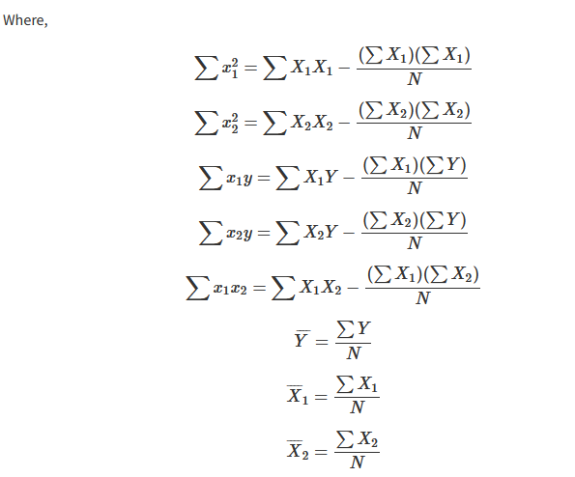
Formula

Slide 5
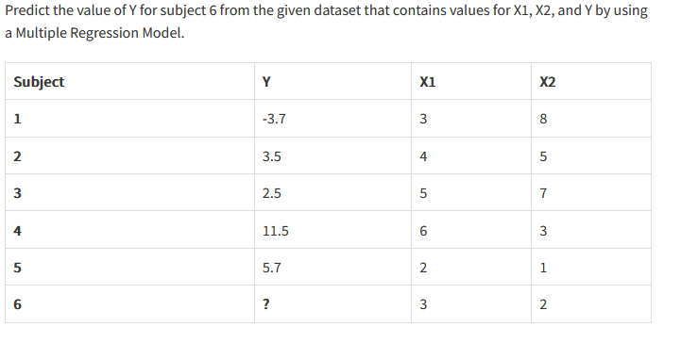
Numerical

Slide 6
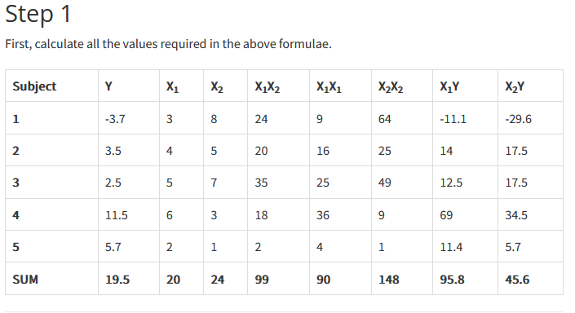

Slide 7
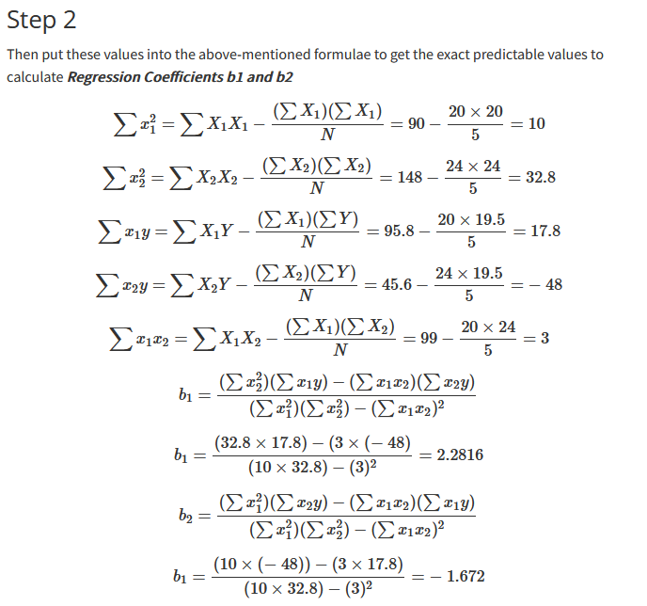

Slide 8
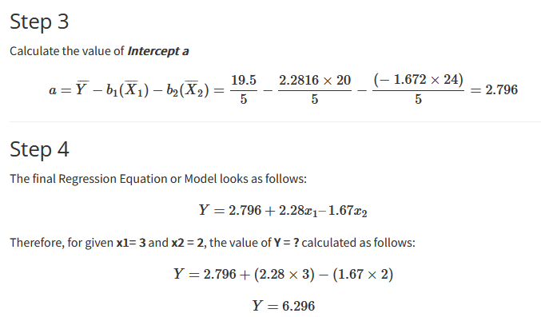

Slide 9
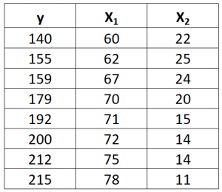
Numerical
Suppose we have the following dataset with one response variable y and two predictor variables X₁ and X₂:
Use the following steps to fit a multiple linear regression model to this dataset.

Slide 10
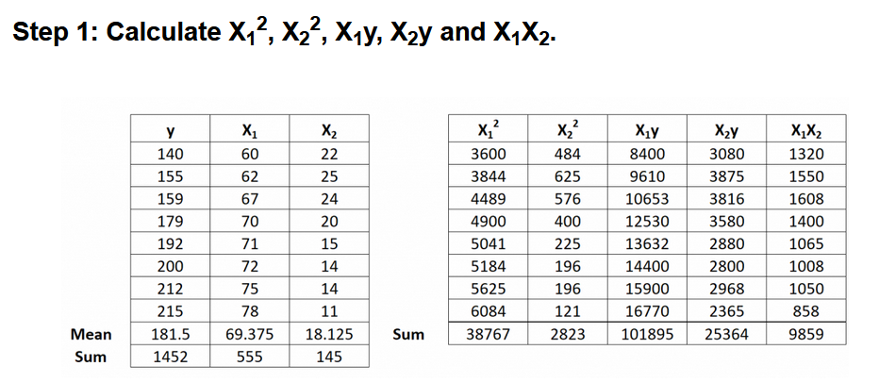

Slide 11
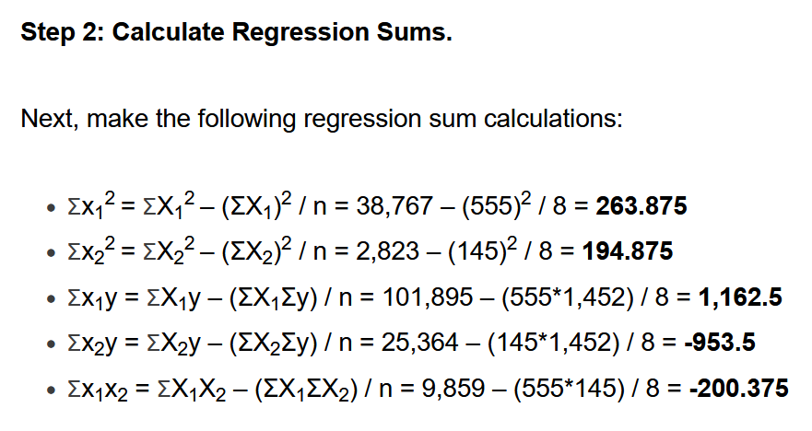

Slide 12
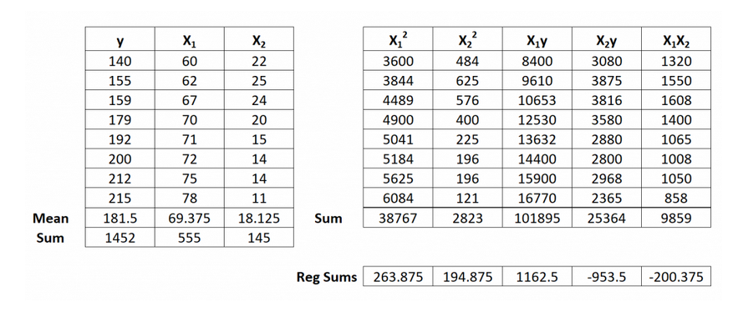

Slide 13
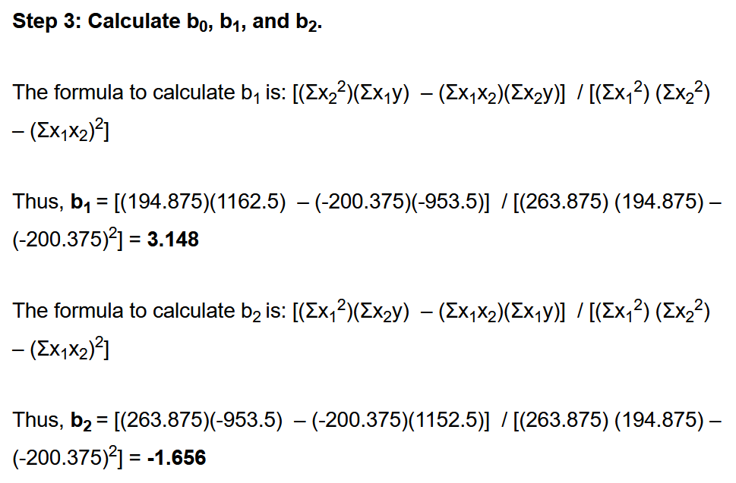

Slide 14
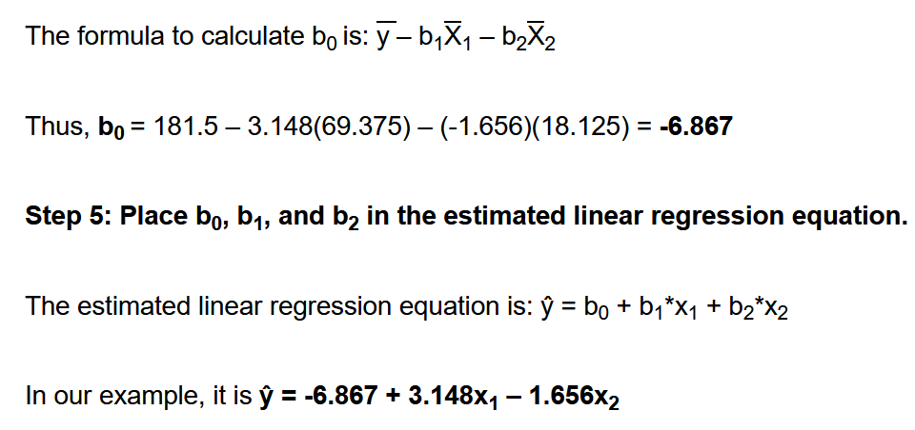

Slide 15
Numerical
Find multiple linear regression equation of y on X1 and X2
y | 4 | 6 | 7 | 9 | 13 | 15
X1 | 15 | 12 | 8 | 6 | 4 | 3
X2 | 30 | 24 | 20 | 14 | 10 | 4
Ans:
Regression coefficient are:
b1= 0.389, b2=0.623
b0= 16.479
Write a multiple linear regression equation

Slide 16
Partial regression coefficient
A partial regression coefficient is the name given to the regression coefficients in a multiple linear regression model.
This is in contrast to a plain old “regression coefficient”, which is the name given to the regression coefficient in a simple linear regression model.
The way to interpret a partial regression coefficient is: The average change in the response variable associated with a one unit increase in a given predictor variable, assuming all other predictor variables are held constant.

Slide 17
Partial regression coefficient
Interpreting Partial Regression Coefficients
Suppose one has to know if the number of hours spent studying and the number of prep exams taken affects the score that a student receives on a certain college entrance exam.
To explore this relationship, one can fit a multiple linear regression model using hours studied and prep exams taken as predictor variables and exam score as a response variable.

